Slide 1


BAYESIAN CLASSIFICATION OF RESEARCH PAPERS
Huilin Chang(hc5hq) , Yihnew Eshetu (yte9pc), Celeste Lemrow (ctl7t)
DS6014 Project

Slide 2
TABLE OF CONTENTS
Introduction
Data Extraction
Exploratory Analysis
Methods
Results
Conclusions

Slide 3
INTRODUCTION
One of the Internet Archive’s mission areas is “Universal Access to All Knowledge”, which is an attempt to collect and provide access to the “scholarly web”: the public record of research publications and datasets available on the world wide web.
Our project aims to help this mission by implementing a fast PDF identification tool, which will score files on their likelihood of being a research publication.
Given the volume of PDF documents in the Internet Archive’s (IA) repository, a classifier is needed to determine which are legitimate research documents
Our group constructed several Bayesian logistic models with different feature combinations and compared results on accuracy of identification of research papers

Slide 4
DATA EXTRACTION
Dataset
Num Pages
ParsePDF Class
Meta Data
Height
PDF Files
Width
Size
Image Spec
Structure
Content
Association
Text Analysis
Language
Num Characters
Research Publication
Language: English, Romance, and other
Structure: Words that represent the structure of a paper
{abstract, introduction, conclusion, reference, table of content}
Content: Words that represent the content of a paper
{research, analyze, result, table, investigation, explain, theory, study, paper, data, perform}
Association: Words that represent association
{journal, association, organization, doi, university, school, board}

Slide 5
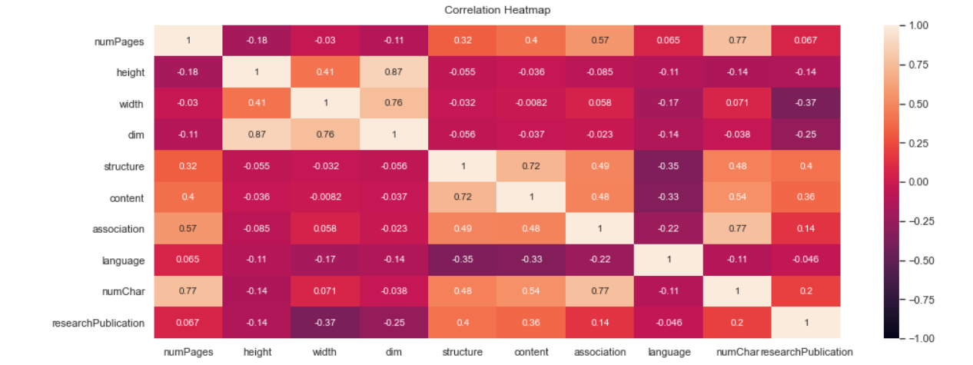
EXPLORATORY ANALYSIS
Correlation matrix : correlation between the research publication variable and selective features

Slide 6
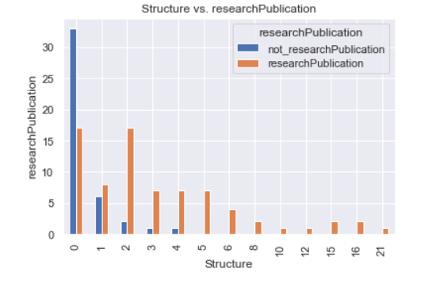
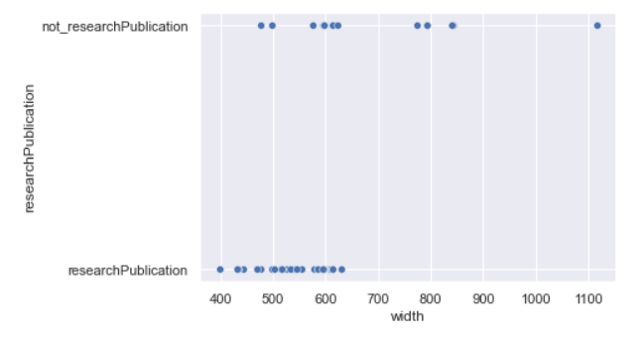
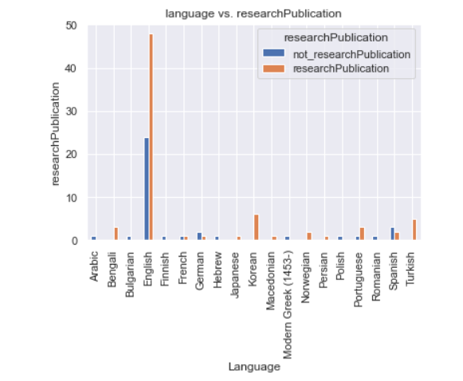
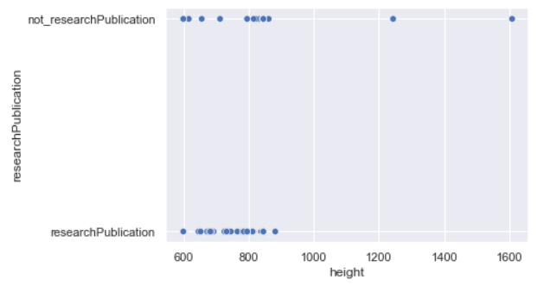
EXPLORATORY ANALYSIS
Structure vs. Research Publication
Width vs. Research Publication
Language vs. Research Publication
Height vs. Research Publication

Slide 7
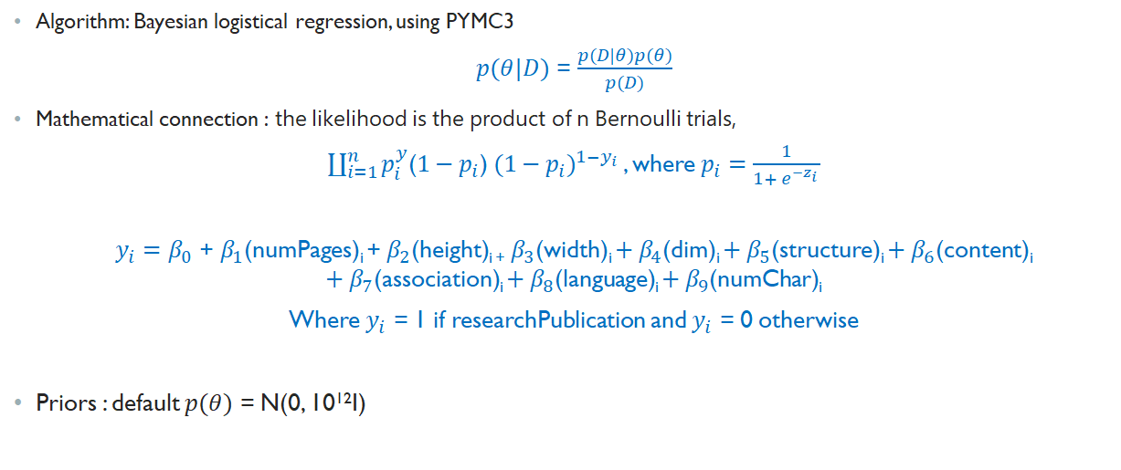
BAYESIAN STATISTICS

Slide 8
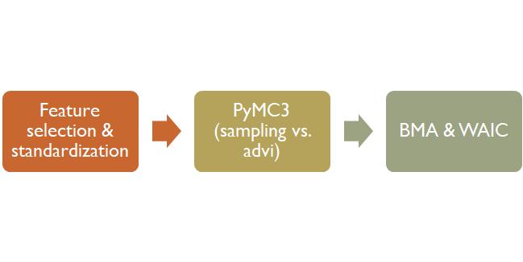
METHODS
Total set of features considered: number of pages, height, width, dimensions of page, structure, content, association, language, number of characters
How likely is it a research publication based on the selective features?
Model comparison approach – compared different sets of features and accompanying accuracy. Given parameters for the capstone project, including speed, prioritizing a balance of the smallest number of features with acceptable accuracy is a key objective
PyMC3
GLM: Logistic Regression :
(sampling)
ADVI variational inference
(optimization)
ELBO

Slide 9
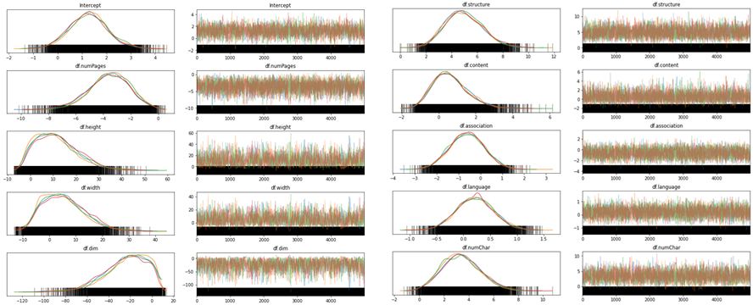
RESULTS - Full Model (Sampling)
Notes:
https://docs.pymc.io/notebooks/GLM-logistic.html
https://mc-stan.org/docs/2_24/cmdstan-guide/variational-inference-algorithm-advi.html
https://pymc3-testing.readthedocs.io/en/rtd-docs/notebooks/bayesian_neural_network_advi.html
Markov chain Monte Carlo

Slide 10
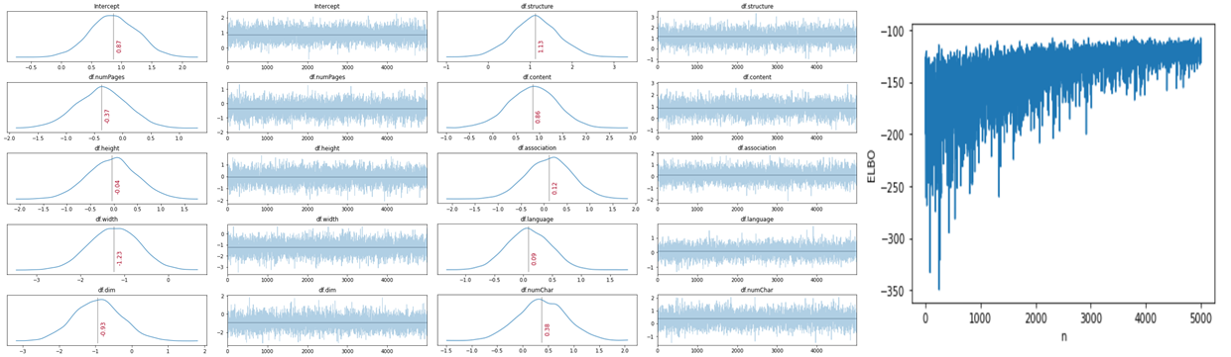
RESULTS - Full Model (ADVI)
Variational Inference: ADVI
Notes:
https://docs.pymc.io/notebooks/GLM-logistic.html
https://mc-stan.org/docs/2_24/cmdstan-guide/variational-inference-algorithm-advi.html
https://pymc3-testing.readthedocs.io/en/rtd-docs/notebooks/bayesian_neural_network_advi.html
Markov chain Monte Carlo

Slide 11
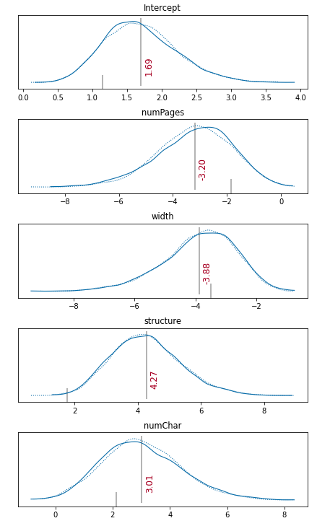
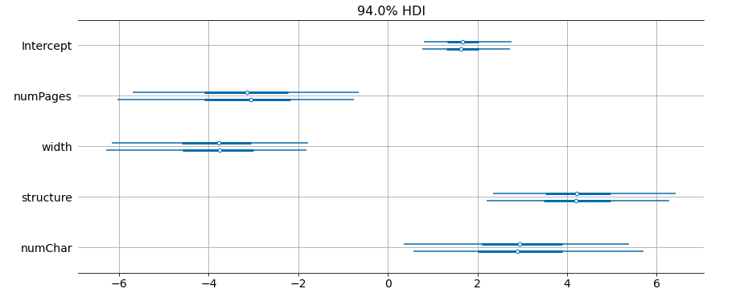
RESULTS - Model 1
Notes:
https://docs.pymc.io/notebooks/GLM-logistic.html
https://mc-stan.org/docs/2_24/cmdstan-guide/variational-inference-algorithm-advi.html
https://pymc3-testing.readthedocs.io/en/rtd-docs/notebooks/bayesian_neural_network_advi.html
Markov chain Monte Carlo

Slide 12
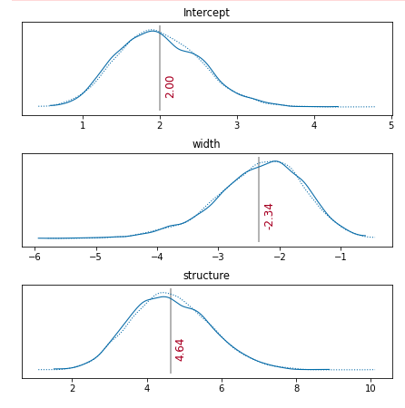
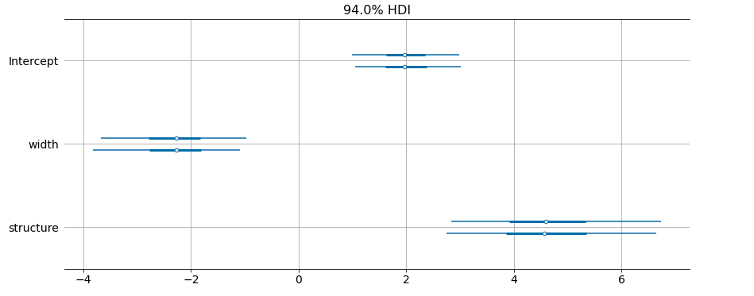
RESULTS - Model 2
Notes:
https://docs.pymc.io/notebooks/GLM-logistic.html
https://mc-stan.org/docs/2_24/cmdstan-guide/variational-inference-algorithm-advi.html
https://pymc3-testing.readthedocs.io/en/rtd-docs/notebooks/bayesian_neural_network_advi.html
Markov chain Monte Carlo

Slide 13
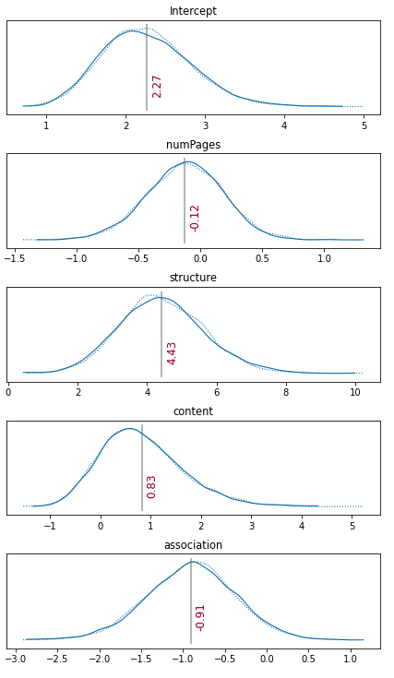
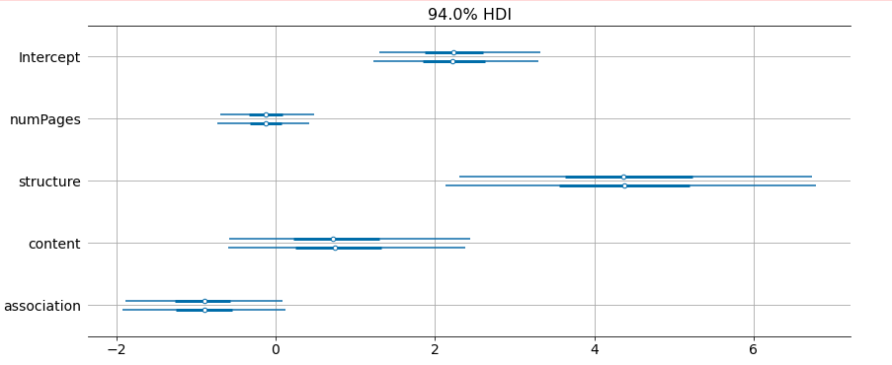
RESULTS - Model 3
Notes:
https://docs.pymc.io/notebooks/GLM-logistic.html
https://mc-stan.org/docs/2_24/cmdstan-guide/variational-inference-algorithm-advi.html
https://pymc3-testing.readthedocs.io/en/rtd-docs/notebooks/bayesian_neural_network_advi.html
Markov chain Monte Carlo

Slide 14
RESULTS - BMA - Top Models
Model | Features | Likelihood
1 | number of pages, width, structure, number of characters | 1.03e-23
2 | width, structure | 6.20e-23
3 | number of pages, structure, number of characters | 5.71e-24
Notes:
https://docs.pymc.io/notebooks/GLM-logistic.html
https://mc-stan.org/docs/2_24/cmdstan-guide/variational-inference-algorithm-advi.html
https://pymc3-testing.readthedocs.io/en/rtd-docs/notebooks/bayesian_neural_network_advi.html
Markov chain Monte Carlo

Slide 15
RESULTS - WAIC
Model | Features | WAIC
1 - Top model from BMA | number of pages, width, structure, number of characters | 95.0114
2 - 2nd best model from BMA | width, structure | 95.291
3 - Selected out of curiosity | structure, content, association | 119.888
4 - Full model | number of pages, height, width, dimension, structure, content, association, language, number of characters | 95.1717
5 - Simple model (also selected out of curiosity) | structure | 95.1717
Notes:
https://docs.pymc.io/notebooks/GLM-logistic.html
https://mc-stan.org/docs/2_24/cmdstan-guide/variational-inference-algorithm-advi.html
https://pymc3-testing.readthedocs.io/en/rtd-docs/notebooks/bayesian_neural_network_advi.html
Markov chain Monte Carlo

Slide 16
PREDICTION COMPARISON
Model | Features | Accuracy
1 - Top model from BMA | number of pages, width, structure, number of characters | 78.3%
2 - 2nd best model from BMA | width, structure | 75%
3 - Selected out of curiosity | structure, content, association | 80%
4 - Full model | number of pages, height, width, dimension, structure, content, association, language, number of characters | 77%
5 - Simple model (also selected out of curiosity) | structure | 76.7%
Notes:
https://docs.pymc.io/notebooks/GLM-logistic.html
https://mc-stan.org/docs/2_24/cmdstan-guide/variational-inference-algorithm-advi.html
https://pymc3-testing.readthedocs.io/en/rtd-docs/notebooks/bayesian_neural_network_advi.html
Markov chain Monte Carlo

Slide 17
CONCLUSIONS
Key findings:
Top feature - structure
Additional key features - number of pages, width
Format matters, in addition to content
Simple model may be reasonable, given comparable accuracy to others, to prioritize speed
Future work:
Cross-validation for further comparison
Additional investigation into models focused on the language model (structure, content, association)
Use LDA dimension reduction to assess whether it generates improved results
Expand analysis to larger dataset
Address non-English language factors in the model

